Slide 1



Behavior Driven Development – Why ?
Introduction BDD & ATDD - Why
Definition : « A collaborative process that creates a shared understanding of requirements between the business and the agile teams».
Business
Tester
Developer
Notes:
Reduce the gap between Business and Software Development.

Slide 2
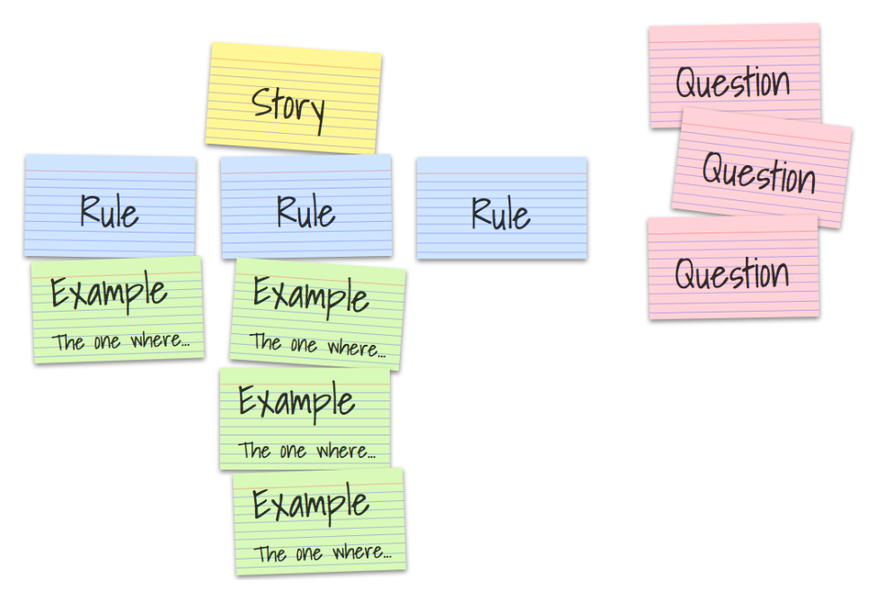
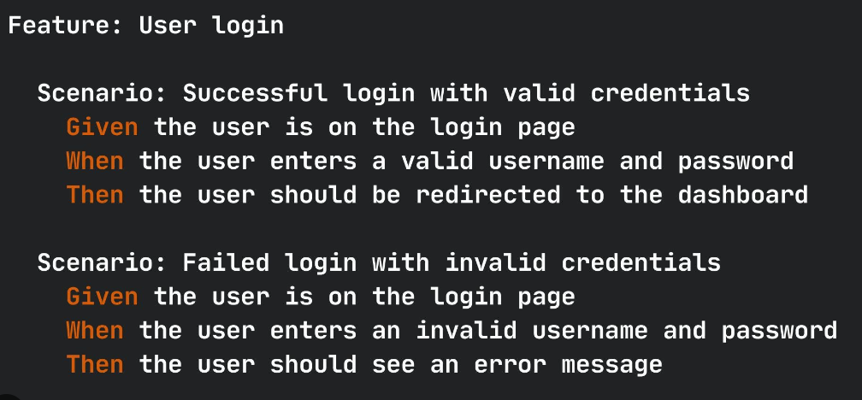

Behavior Driven Development – How ?
3 Amigos / Refinement
Output

Slide 3
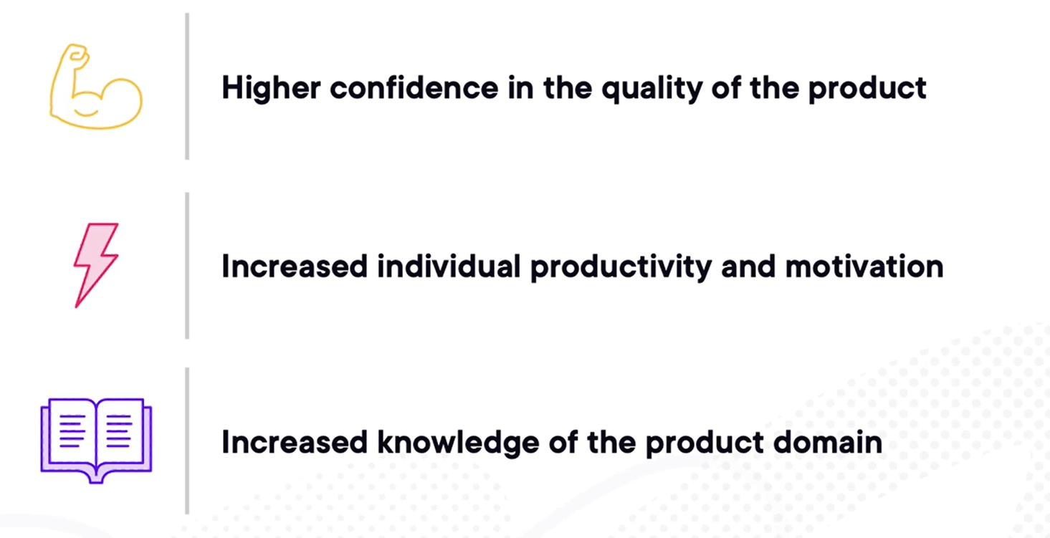
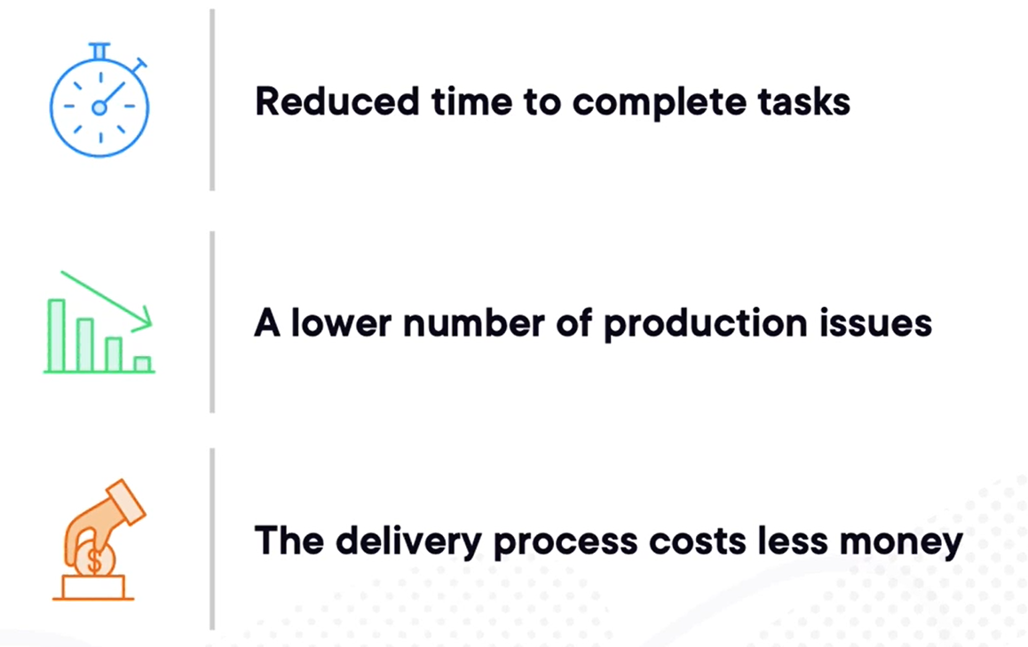
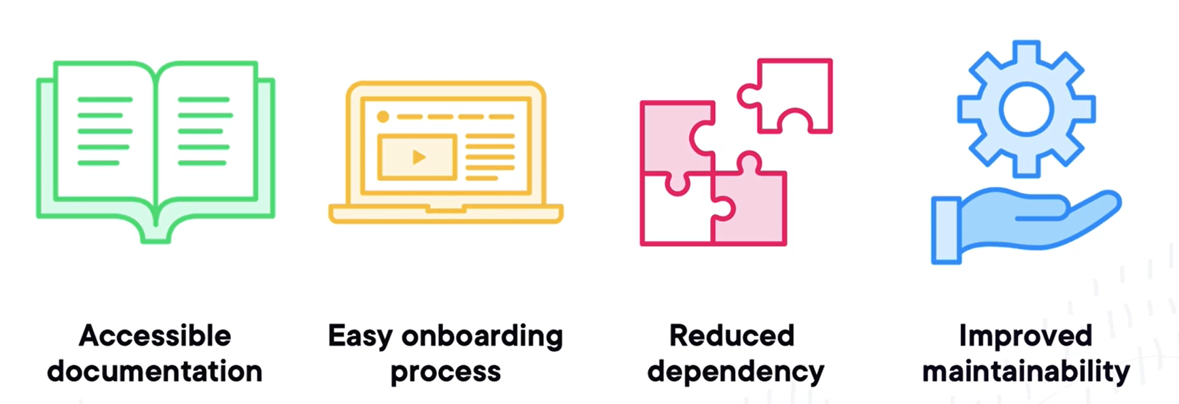
Behavior Driven Development – Benefits

Slide 4
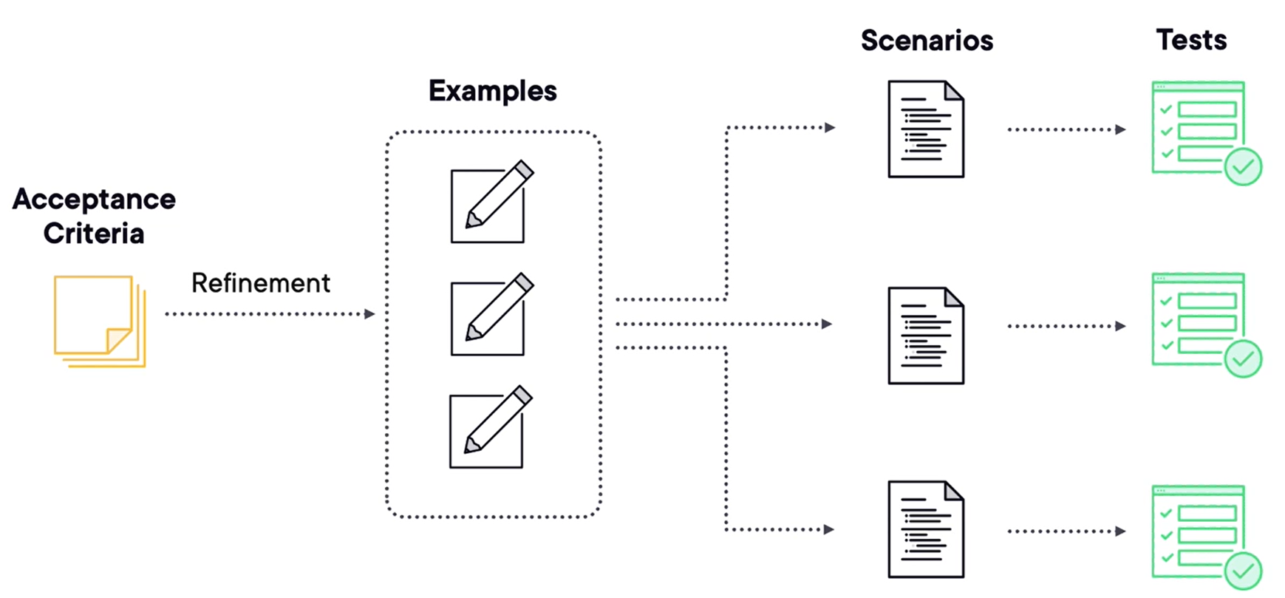
Behavior Driven Development
Notes:
Reduce the gap between Business and Software Development.

Slide 5
Resources
https://app.pluralsight.com/library/courses/behavior-driven-development-big-picture/table-of-contents
https://cucumber.io/blog/bdd/example-mapping-introduction/
https://capgemini.sharepoint.com/sites/ITpourtous/SitePages/S%C3%A9rie-sur-le-testing.aspx

Slide 6
Test Driven Development – Why ?
Definition : « A software development practice that emphasis writing tests before writing the actual code ».
Code Coverage
Less Technical Debt
Prevent bugs
Easier maintenance
Documentation
Refactoring with confidence
Cleaner Code

Slide 7
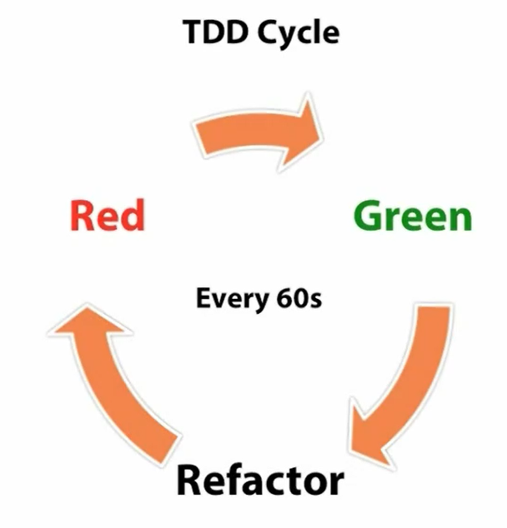
TDD – How ?
Write a failing test
Make it pass
Refactor
Small and concise (modularize), better design.

Slide 8
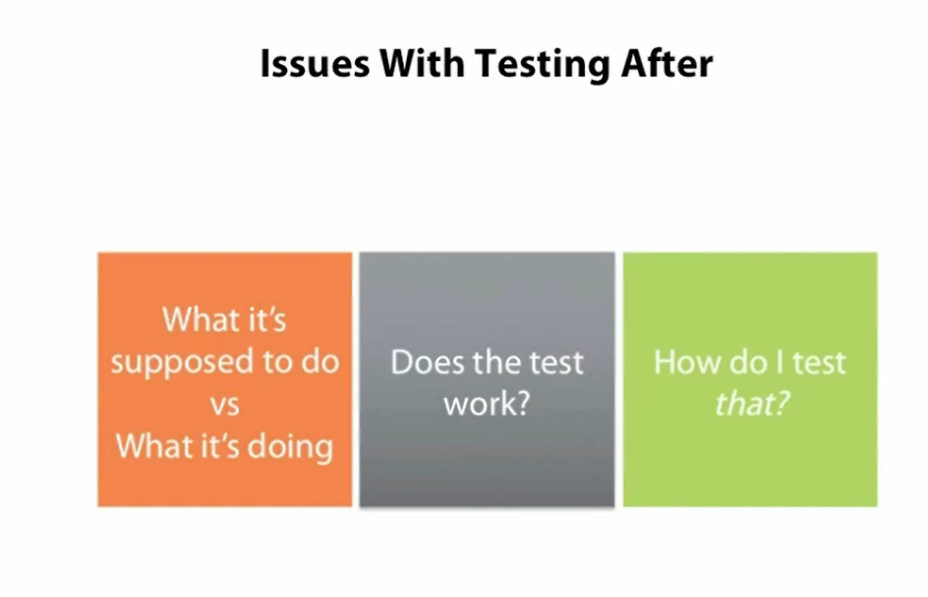
No TDD – Issues
What it’s supposed to do vs What it’s doing.
Your code becomes the specification for your test.
Does the tests work ? You will end up modifying your test and not your code.
How do I test the code I’ve just written ?

Slide 9
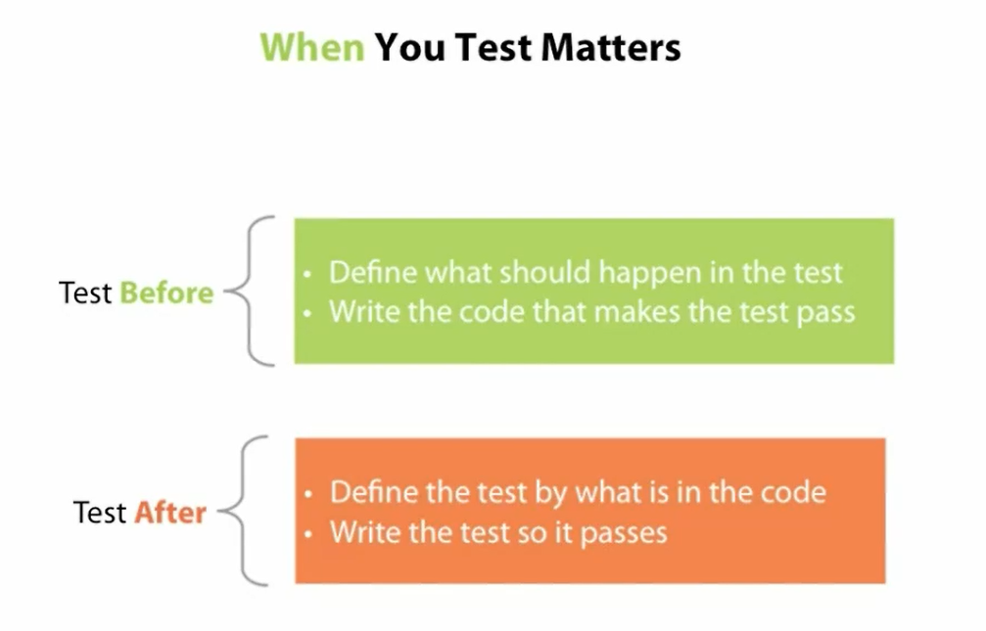
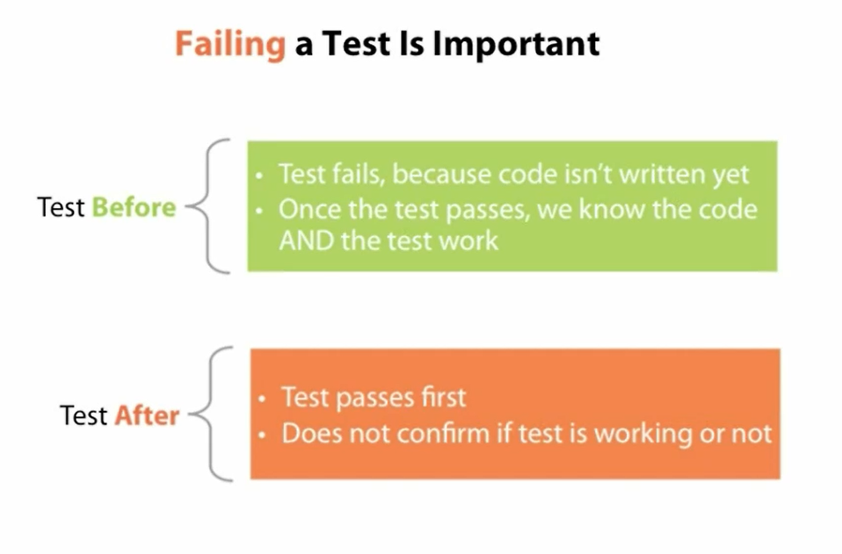
TDD – As a Spec
The test is the codified version of the spec.

Slide 10
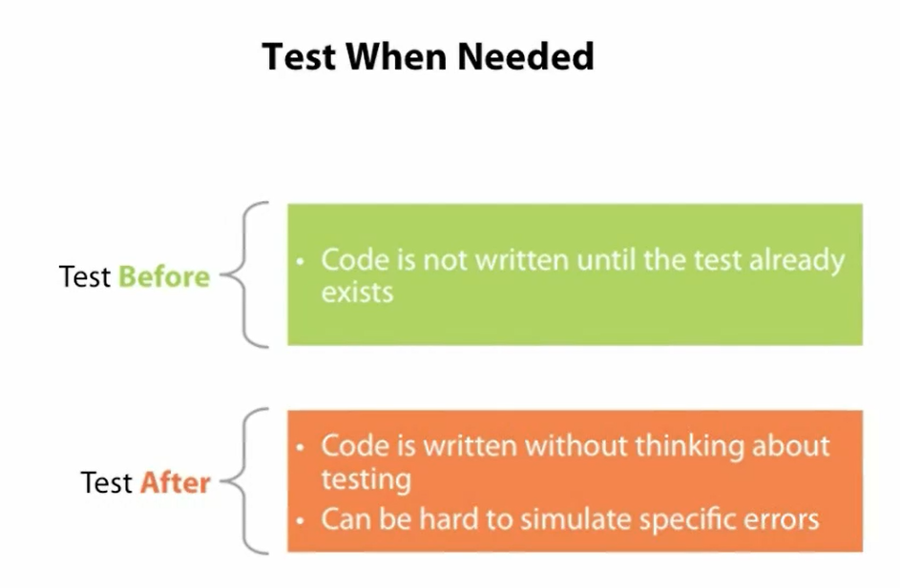

Slide 11
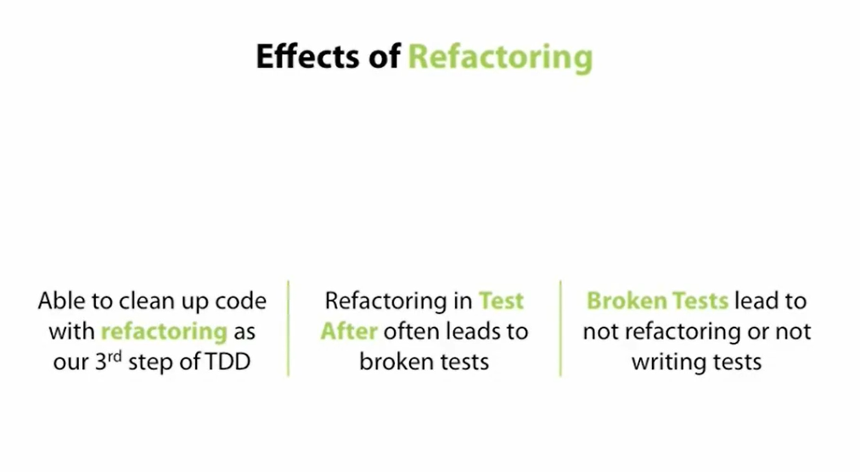

Slide 12
